Slide 1



HR Analytics
Dashboard
SQL-Driven Insights with Power BI Visuals
Presented By • Nikhil Rane

Slide 2
Turn HR data into decisions
A focused briefing for HR professionals and business leaders.
01
02
03
SHOWCASE
VISUALIZE
ENABLE
SQL-based HR data analysis
25 business questions in Power BI
Faster, evidence-led HR decisions

Slide 3
SQL methodology for HR analytics
From five operational tables to one analysis-ready workforce view.
EMPLOYEES
DEPARTMENTS
SALARIES
ATTENDANCE
PERFORMANCE
SELECT
100.0 * SUM(CASE WHEN status IN ('Resigned','Terminated') THEN 1 ELSE 0 END)
/ COUNT(*) AS attrition_rate
FROM employees;
CORE TECHNIQUES
Aggregation • filtering • joins • window functions

Slide 4
25 questions.
One workforce story.
01 Total employees
02 Active employees
03 Attrition rate
04 Average salary
05 Salary / department
06 Salary / designation
07 Performance rating
08 Top performers
09 Bonus distribution
10 Department headcount
11 Gender diversity
12 Age distribution
13 Average tenure
14 New hires / month
15 Attendance rate
16 Leave Utilization
17 Absenteeism Rate
18 Highest Paying Department
19 Highest Paying Job Role
20 Promotion Eligibility List
21 Performance Rating Distribution
22 Employee Growth Trend
23 Employees By City
24 Department-wise Attrition
25 Workload Dashboard Metrics

Slide 5
Total Employees
Power BI metric card placeholder • connect to the validated HR semantic model
SQL INSIGHT
10K
Total employees registered in the system.
TOTAL EMPLOYEES
BUSINESS INSIGHT
Establishes the overall workforce baseline for headcount planning and organizational reporting.

Slide 6
Active Employees
Power BI metric card placeholder • connect to the validated HR semantic model
SQL INSIGHT
7018
Employees whose current employment status is active.
ACTIVE EMPLOYEES
BUSINESS INSIGHT
Provides visibility into the available workforce for operational planning and resource allocation.

Slide 7
Employee Attrition Rate
Power BI metric card placeholder • connect to the validated HR semantic model
SQL INSIGHT
29.82%
Calculates the percentage of employees recorded as Resigned or Terminated against total employees.
EMPLOYEE ATTRITION RATE
BUSINESS INSIGHT
Measures workforce turnover and helps HR identify retention challenges and improve employee engagement.

Slide 8
Average Employee Salary
Power BI metric card placeholder • connect to the validated HR semantic model
SQL INSIGHT
1,36,301
Calculates the average salary across all employee records using aggregate functions.
AVERAGE EMPLOYEE SALARY
BUSINESS INSIGHT
A baseline view of compensation and budget exposure.

Slide 9
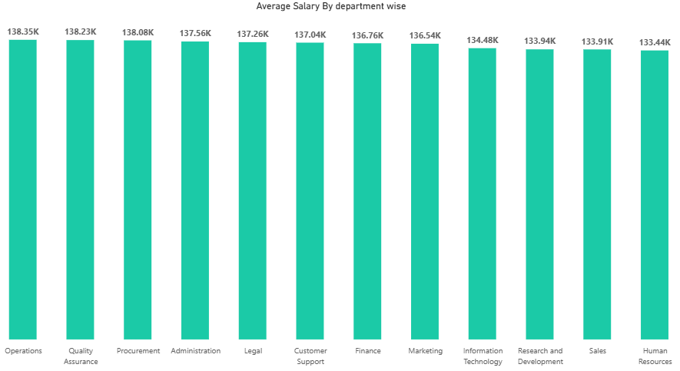
Salary by Department
Illustrative Power BI visual placeholder • replace sample values after model refresh
SQL INSIGHT
Compare average salary grouped by department.
BUSINESS INSIGHT
Identify pay concentration and the highest-paying functions.

Slide 10
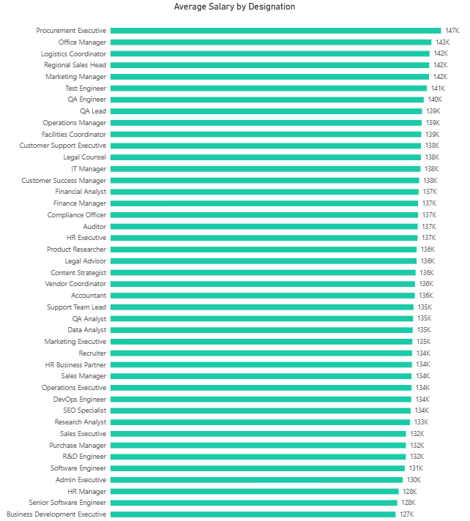
Salary by Designation
SQL INSIGHT
Aggregate mean salary for each role or designation.
BUSINESS INSIGHT
Assess role-based compensation consistency and progression.

Slide 11
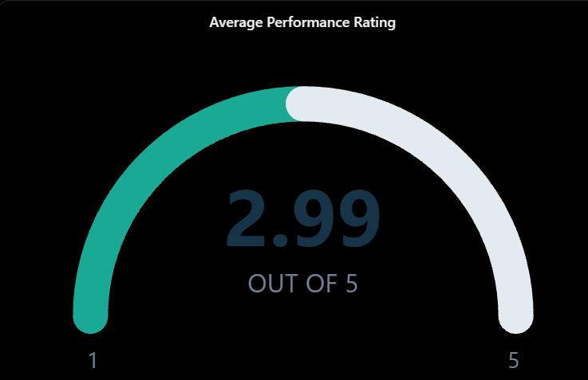
Average Performance Rating
Power BI metric card placeholder • connect to the validated HR semantic model
SQL INSIGHT
2.99 / 5
Mean performance rating across reviewed employees.
AVERAGE PERFORMANCE RATING
BUSINESS INSIGHT
Provides an overview of workforce performance and helps identify opportunities for employee development.

Slide 12
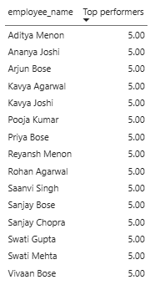
Top Performers
Ranked Power BI table placeholder • employee names intentionally withheld
SQL INSIGHT
Rank employees by performance using a window function.
BUSINESS INSIGHT
Helps identify high-performing employees for recognition, career development, and succession planning.

Slide 13
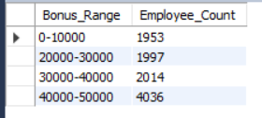
Bonus Distribution
Illustrative Power BI visual placeholder • replace sample values after model refresh
SQL INSIGHT
Analyze the range and frequency of granted bonuses.
BUSINESS INSIGHT
Evaluates incentive allocation and supports fair and performance-based reward strategies.

Slide 14
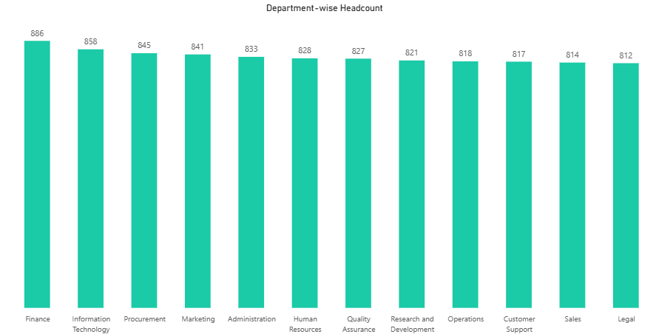
Department-wise Headcount
Illustrative Power BI visual placeholder • replace sample values after model refresh
SQL INSIGHT
Count employees grouped by department.
BUSINESS INSIGHT
Compare department scale and inform resource allocation.

Slide 15
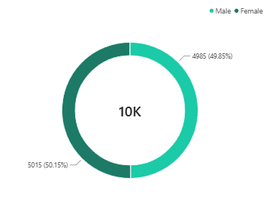
Gender Diversity Ratio
Illustrative Power BI visual placeholder • replace sample values after model refresh
SQL INSIGHT
Calculates employee counts and percentage distribution across recorded gender categories.
BUSINESS INSIGHT
Monitors workforce representation and helps HR evaluate diversity across the organization.

Slide 16
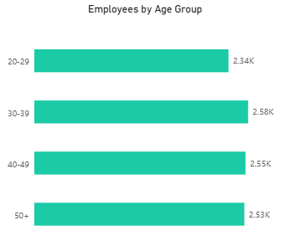
Age Distribution
Illustrative Power BI visual placeholder • replace sample values after model refresh
SQL INSIGHT
Segments employees into age groups and calculates the headcount within each group.
BUSINESS INSIGHT
Support workforce planning, long-term talent and succession planning

Slide 17
Average Employee Tenure
Power BI metric card placeholder • connect to the validated HR semantic model
SQL INSIGHT
6.8 yrs
Average service length derived from employee hire dates.
AVERAGE EMPLOYEE TENURE
BUSINESS INSIGHT
Highlights workforce experience and provides insights into employee retention patterns.

Slide 18
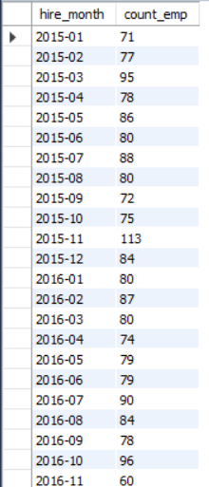
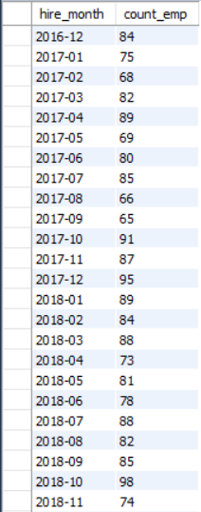
New Hires by Month
Illustrative Power BI visual placeholder • replace sample values after model refresh
SQL INSIGHT
Count hire dates by calendar month.
BUSINESS INSIGHT
Identifies hiring trends and helps HR evaluate recruitment activity and workforce expansion.

Slide 19
Employee Attendance Rate
Power BI metric card placeholder • connect to the validated HR semantic model
SQL INSIGHT
69.16%
Present days divided by total scheduled working days.
EMPLOYEE ATTENDANCE RATE
BUSINESS INSIGHT
Monitor’s employee attendance patterns and helps identify potential workforce availability issues.

Slide 20



Leave Utilization: How much leave have employees taken or utilized?
Power BI visual placeholder • connect to the validated HR semantic model
SQL INSIGHT
1069
Total leave taken or utilized by employees over the selected period.
LEAVES TAKEN
BUSINESS INSIGHT
Helps HR monitor leave patterns and plan staffing requirements during periods of higher leave utilization.

Slide 21




Absenteeism Rate: What is the absenteeism rate relative to total working days?
Power BI metric card placeholder • connect to the validated HR semantic model
SQL INSIGHT
Absenteeism rate is calculated as absent days divided by total working days, expressed as a percentage.
10.1%
ABSENTEEISM RATE
BUSINESS INSIGHT
Helps assess attendance patterns and the understand potential impact of absenteeism on productivity and operations.
(Absent Days / Total Working Days)

Slide 22

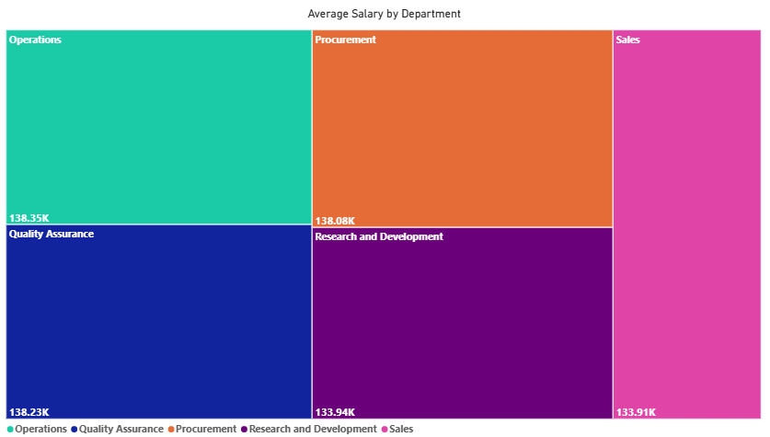


Highest Paying Job Role
Which designation or job role earns the highest average salary?
SQL INSIGHT
Aggregate average salary at the designation level and select the maximum to identify the highest paying role.
BUSINESS INSIGHT
Identifies the top earning job role, informing compensation benchmarking and talent strategy.

Slide 23


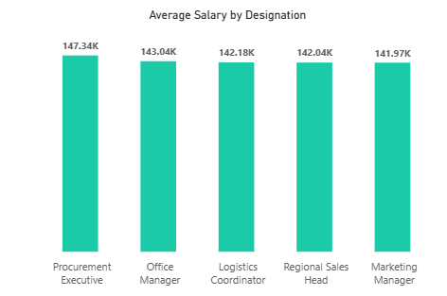

Highest Paying Designation
Which designation earns the highest average salary?
SQL INSIGHT
Aggregates average employee salaries by designation and identifies the designation with the highest average salary.
BUSINESS INSIGHT
Identifies the designation that offers the highest average salary to support compensation benchmarking and
workforce planning.

Slide 24
Promotion Eligibility List
Ranked Power BI table placeholder • employee names intentionally withheld
SQL INSIGHT
Filters and ranks employees based on performance ratings and the defined promotion eligibility criteria
BUSINESS INSIGHT
Helps HR identify potential candidates for career progression and structured succession planning.

Slide 25
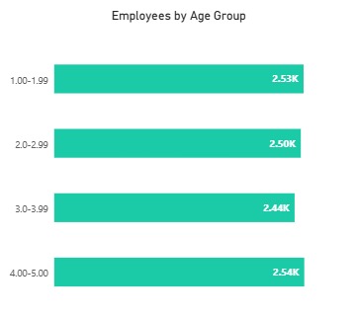
Performance Rating Distribution
Illustrative Power BI visual placeholder • replace sample values after model refresh
SQL INSIGHT
Groups employees by performance rating and calculates the employee count in each rating categorys.
BUSINESS INSIGHT
Reveals overall performance patterns and helps identify areas requiring employee development or recognition.

Slide 26
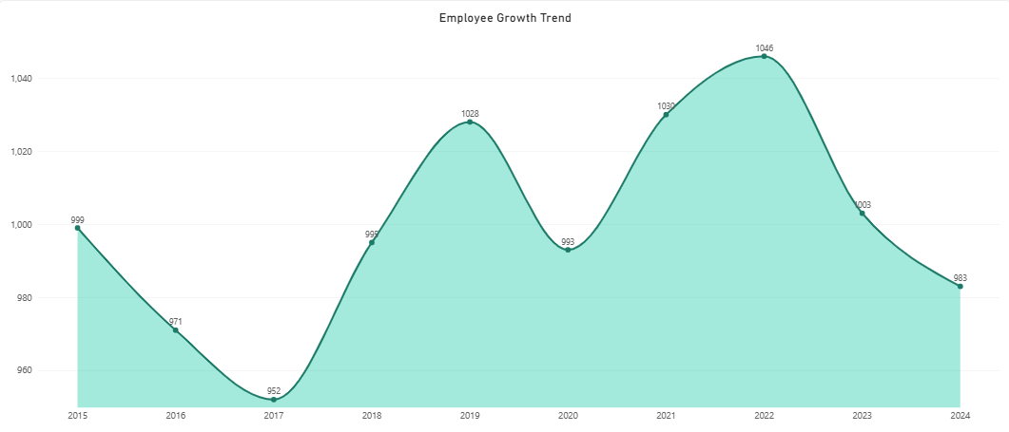
Employee Growth Trend
Power BI metric card placeholder • connect to the validated HR semantic model
SQL INSIGHT
Aggregates employee joining records over time to track changes in workforce headcount.
BUSINESS INSIGHT
Tracks workforce expansion trends and supports future recruitment and capacity planning.

Slide 27
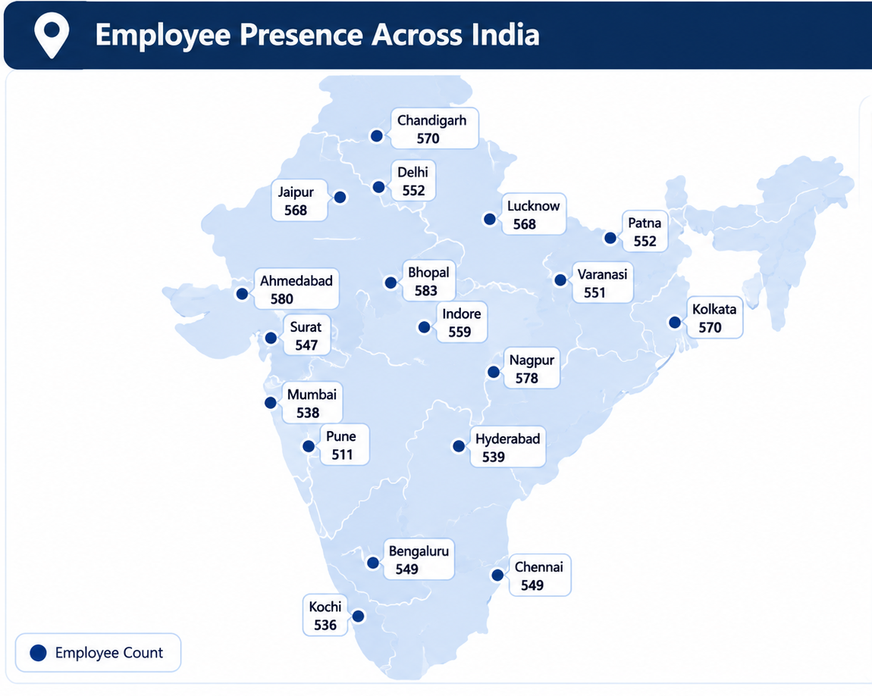
Employees By City
SQL INSIGHT
Groups employee records by city and calculates the headcount for each location.
BUSINESS INSIGHT
Highlights geographical workforce distribution and supports location-wise resource allocation.

Slide 28
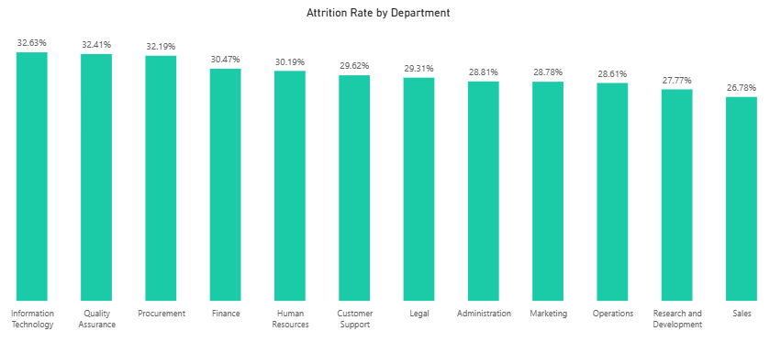
Department wise Attrition
Illustrative Power BI visual placeholder • replace sample values after model refresh
SQL INSIGHT
Groups employees by department and calculates attrition counts or rates for each department.
BUSINESS INSIGHT
Identifies departments experiencing higher employee turnover and helps prioritize retention initiatives.

Slide 29
Recommendations
Four HR decisions to operationalize through owners, thresholds, and monthly review.
01
IMPROVE EMPLOYEE RETENTION
02
IMPPROVE WORKFORCE AVAILABILITY
One of the major findings from my analysis is that the overall attrition rate is 29.82%, which means approximately 2,982 employees are recorded as either resigned or terminated. I would recommend investigating department-wise attrition, employee tenure, and exit reasons to identify the major factors contributing to employee turnover.
Another area I would highlight is employee attendance. The attendance rate is 69.16%, while the absenteeism rate is 10.1%. I would recommend analyzing attendance at department and employee levels to identify recurring patterns and understand where workforce availability could become a concern.
03
OPTIMIZE COMPENSATION PLANNING
04
STRENGTHEN EMPLOYEE DEVELOPMENT
In the salary analysis, Procurement Executive has the highest average salary among the listed designations, at approximately ₹1.47 lakh. This analysis can help HR understand compensation differences across roles and review whether the salary structure is consistent with job responsibilities and experience.
The average performance rating is 2.99 out of 5. Instead of looking only at the average, I would recommend examining the rating distribution to identify high performers and employees who may benefit from additional training or development.

Slide 30
Thank you.
Thank you for viewing the HR Analysis presentation.
Your attention is greatly appreciated.

